Slide 1


DATA ANALYSIS
REPORT

Slide 2


Today's agenda
Project recap
Problem
The Analytics team
Process
Insights
Summary

Slide 3

CLIENT NAME: SOCIAL BUZZ
INDUSTRY: CONTENT CREATION
An audit of their big data practice
Recommendations for a successful IPO
An analysis of their content categories that highlights the top 5 categories with the largest aggregate popularity
Project Recap

Slide 4

Problem
The client has reached a massive scale in recent years and does not have the internal resources to handle it.
Finding Social Buzz’s top 5 categories

Slide 5



Andrew Fleming (Chief Technical Architect)
The Analytics team
Marcus Rompton (Senior Principle)
Ashreen Kaur(Data Analyst)

Slide 6
Process
1
DATA UNDERSTANDING
2
DATA CLEANING
3
DATA MODELLING
4
DATA ANALYSIS
5
DATA INSIGHTS

Slide 7

Insights
16 CATEGORIES
TOP CATEGORY: ANIMALS
3 Major Sentiments

Slide 8
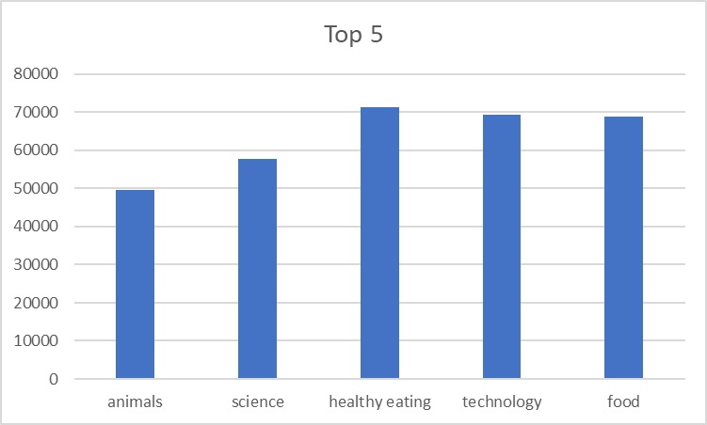

Slide 9
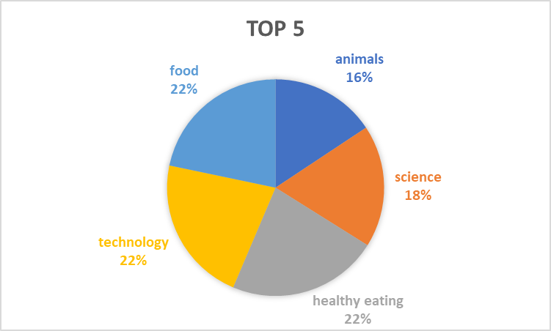
POPULARITY PERCENTAGE

Slide 10
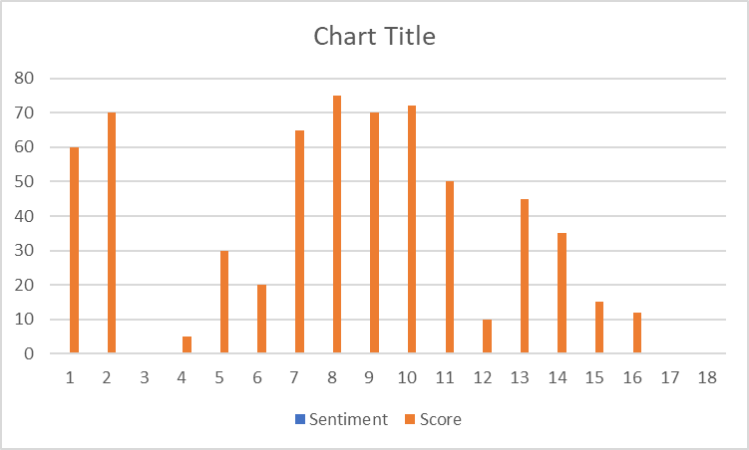
SENTIMENT ANALYSIS

Slide 11

Top five categories are:
ANIMALS
SCIENCE
HEALTHY EATING
TECHNOLOGY
FOOD
This gives us an idea about what content people want to watch.
Healthy eating and food both being top 5 indicate that people are enthusiastic about what they put in their body.
Summary

Slide 12
Thank you!
ANY QUESTIONS?

